Slide 1
Test Case Design
with Use Case Reference

Slide 2
What is a Use Case
A use case documents an action that an actor can perform on the proposed software application.
Actor can be a person or another software or time.
Use Cases are discussed by Business Analysts with Business Stakeholders and documented as Use Case Specifications.
A software application may have 100s of use cases i.e. ways in which users can use the software.
A use case diagram provides visual representation of use cases supported by the proposed application.

Slide 3
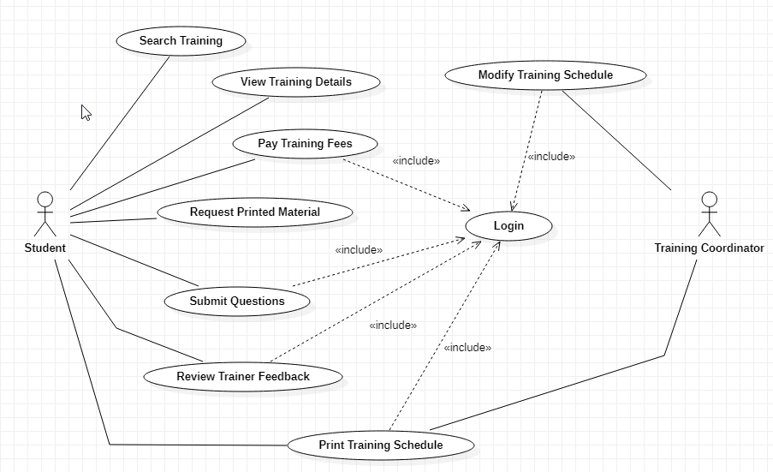
Use Case Diagram
Partial Use Case Diagram for a Training Management System

Slide 4
What is a Use Case
Typical use cases are CRUD operations:
Example: Training Management System
Create Training
Retrieve Training Details
Update Training
Delete Training
A use case includes “use case scenarios”:
Happy Path: Expected behavior of the software when all valid data is available and entered.
Exception Path: All error conditions the software is expected to handle in the context of the use case if invalid data is entered or expected conditions are not met.
Alternate Path: Alternate way to achieve the same end result as Happy Path, but without following the same steps as mentioned in the Happy Path. Alternate Path is optional and purely based on requirements.

Slide 5
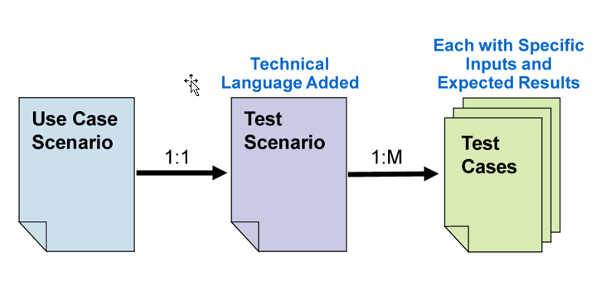
Test Case Design using Use Cases
Each use case scenario is one focus area for testing the software.
Each use case can potentially have three test scenarios - Happy Path testing, Exceptions testing, Alternate Path testing.
Each test scenario will need to be tested using multiple test cases.

Slide 6
Sample - Login Use Case
Happy Path
Enter correct username and password, user should be able to view home page.
Exceptions
Incorrect username and password entered, system should display error “Please enter correct username and password”.
Incorrect username and password entered more than three times, system should get locked for 5 minutes. Display error message “Login Failed - Account locked due to 3 consecutive attempts with incorrect password. Try again after 5 minutes with correct password”.
Password expired. System should display error “Login Failed - Password Expired. Please reset password”
Alternate Path:
None

